Slide 1

EchoVerse
BOOK-RECOMMENDER-WITH-AI-QUIZ-GENERATOR

Slide 2
CONTENTS
Introduction
Functionalities
Technology Stack
Implementation
Demo/Snaps
Future Enhancement
References
Gratitude

Slide 3


Introduction
What is EchoVerse ?
EchoVerse is a Book Recommender System which is an AI-powered tool that suggests books to users based on their preferences, behaviour, and reading patterns. The goal is to improve the user experience by helping them discover books they are likely to enjoy.

Slide 4


FUNCTIONALITIES
Book Discovery
Personalized Experience
User Retention
AI Quiz Generator

Slide 5
FRONTEND
TECHNOLOGY STACK
Programming Language : HTML, CSS
BACKEND
Programming Language : Python
Libraries
Numpy
Pandas
Sklearn
Pickle

Slide 6







User Profile
Information about Users.
(reading history, preference, ratings.)
IMPLEMENTATION WORKFLOW
Book Database
Vast Collection of Books.
(title, author, genre, reviews, etc.)
Recommends Books
Collaborative Filtering.
(uses data from similar users.)

Slide 7

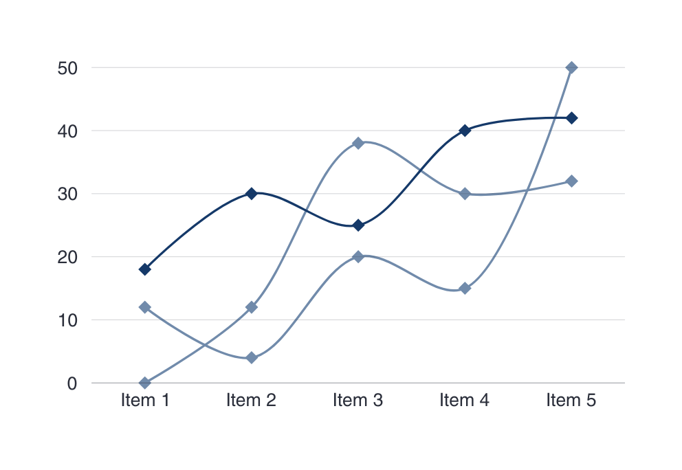
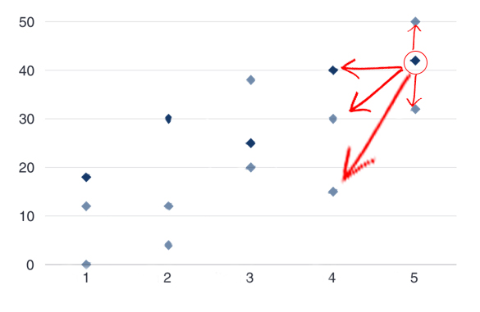
Diagram :-
For Collaborative Filtering :-
Collaborative filtering is a recommender
system that suggests items to users based
on the Preference of similar users . it`s
a popular technique used in
music and movie recommendations
Ratings of user2
Ratings of user1

Slide 8
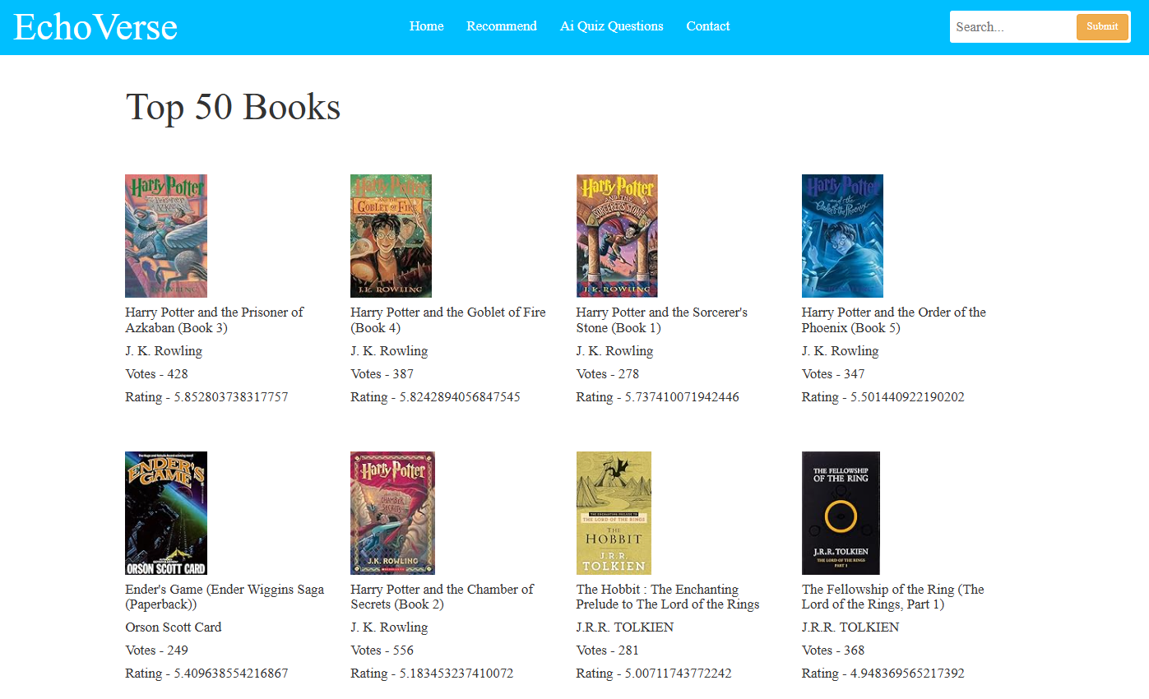
DEMO/ SCREENSHOTS
FRONTEND

Slide 9
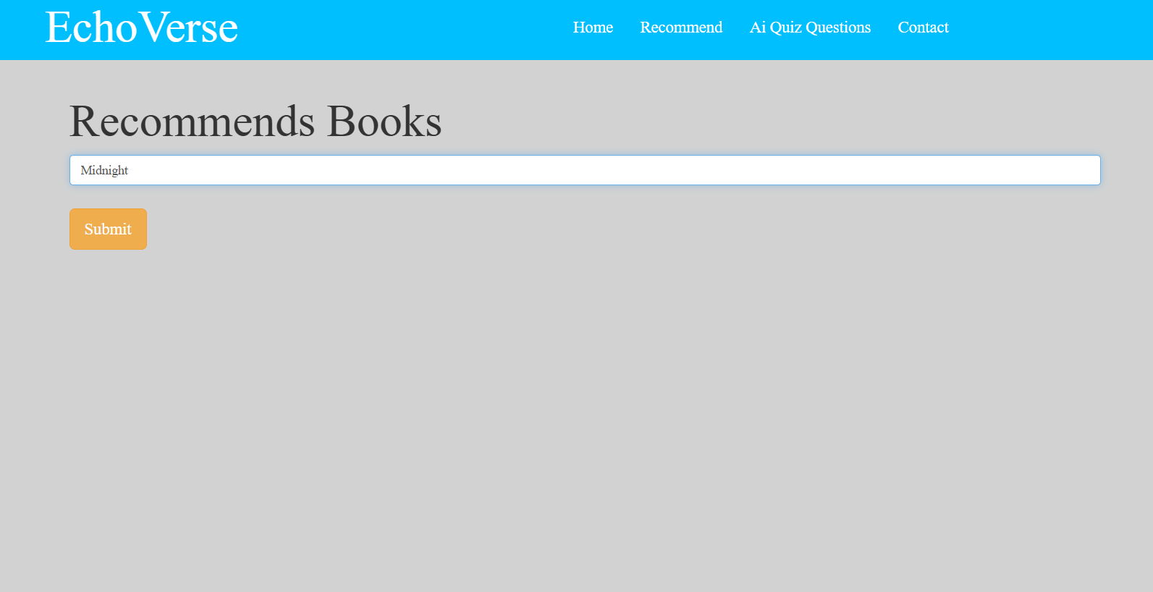
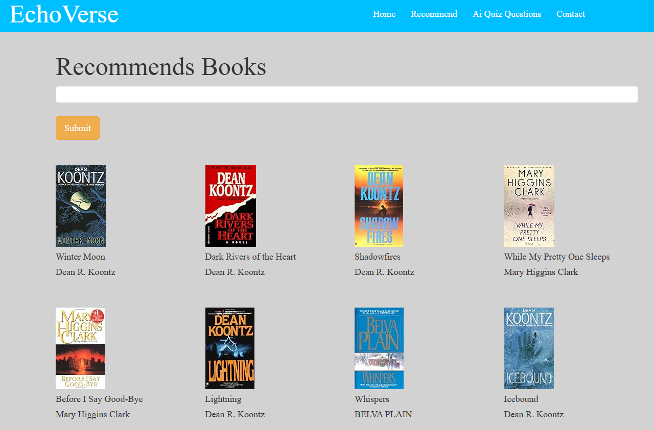
DEMO/ SCREENSHOTS
WORKING

Slide 10
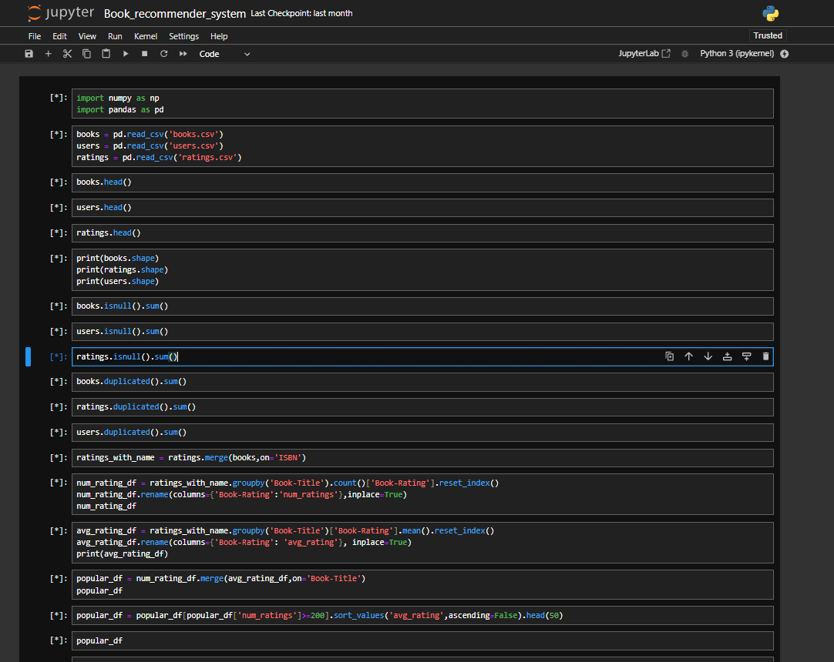
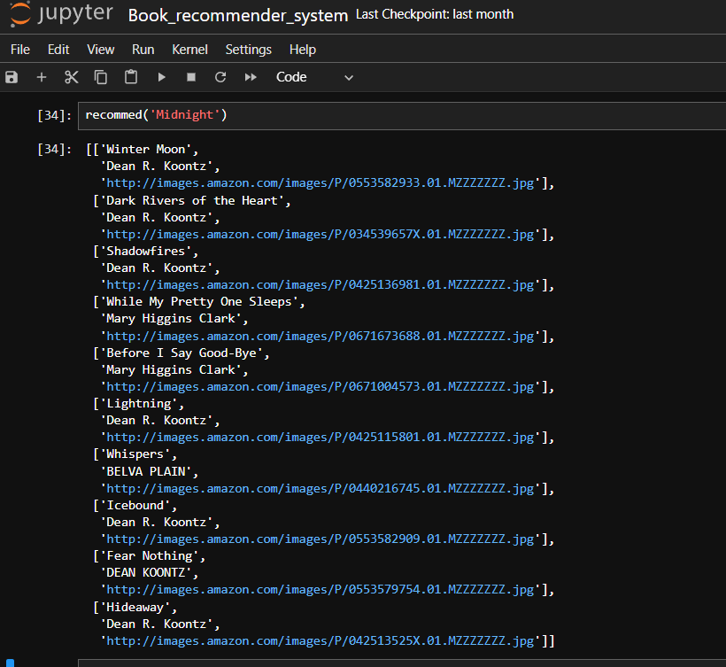
DEMO/ SCREENSHOTS
BACKEND

Slide 11
FUTURE ENHANCEMENTS
01.
02.
03.
04.
05.
AI
Will generate quiz
From selected
Books
Engaging
UI/UX
PDF of Books
Will available
soon
Wide range and
Varities of Books
Introducing
Audiobooks
soon

Slide 12
DEMO/ SCREENSHOTS
FRONTEND

Slide 13
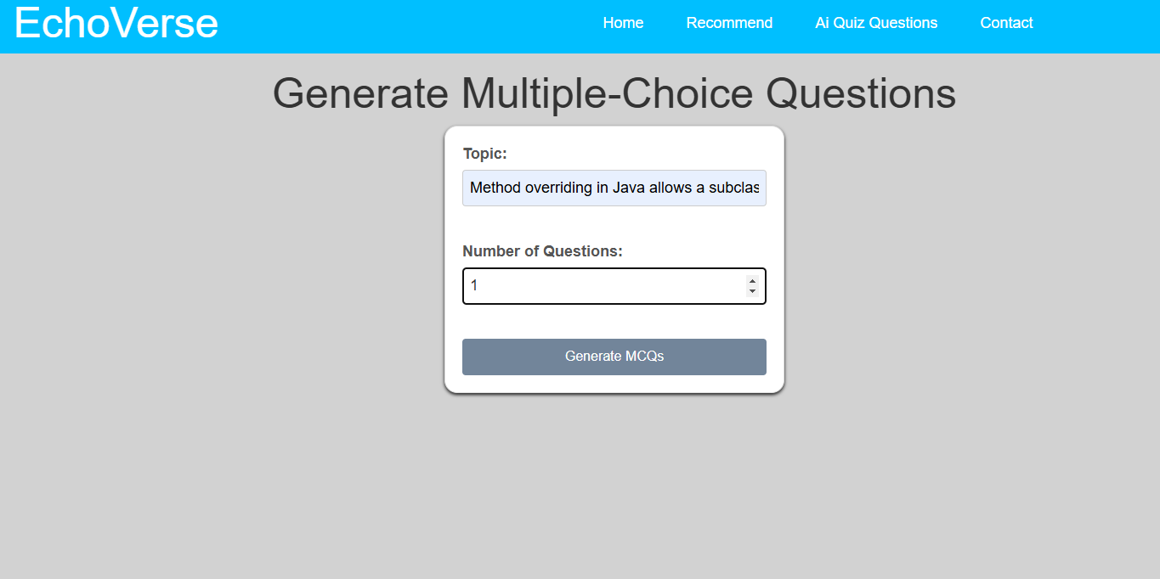
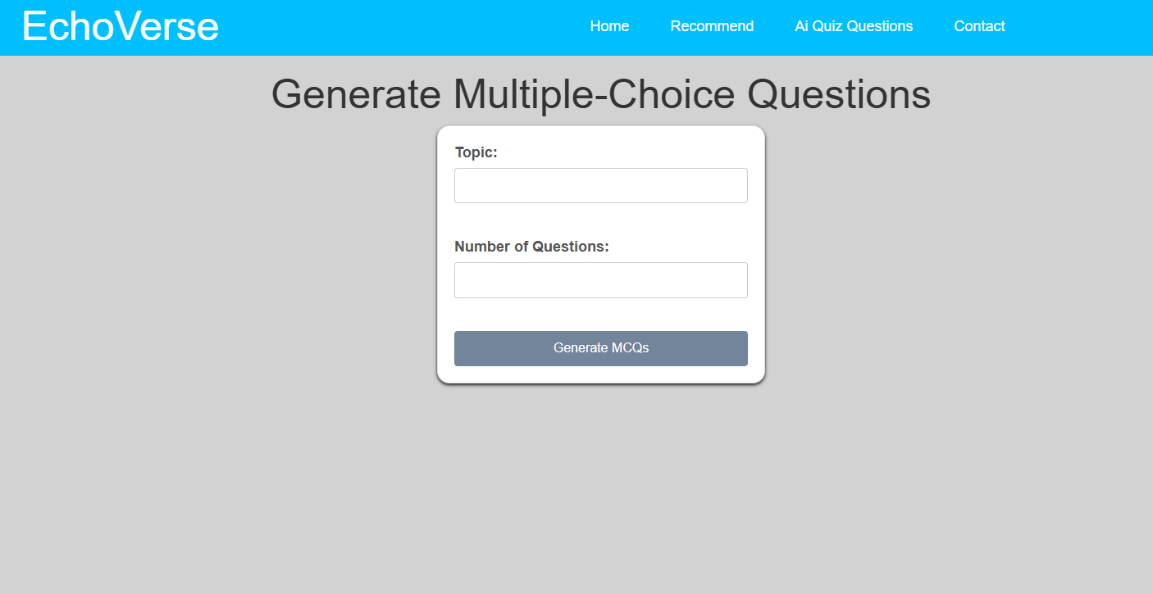
DEMO/ SCREENSHOTS
WORKING

Slide 14
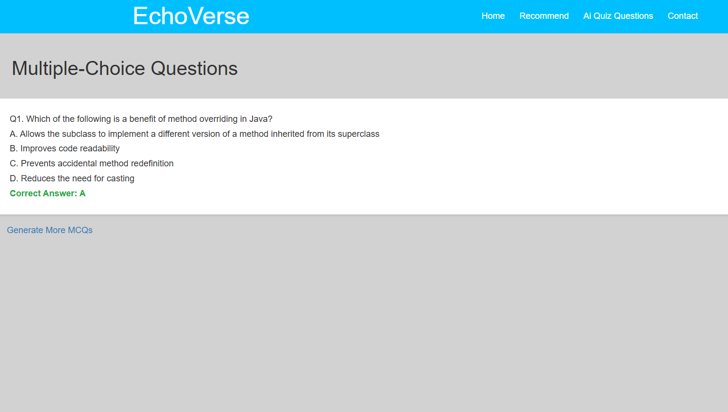
DEMO/ SCREENSHOTS
FRONTEND

Slide 15
REFERENCES
Datasets :-https://www.kaggle.com/datasets/arashnic/
book-recommendation-dataset

Slide 16
Thanking
You

